Slide 1
Civil-Military Relations in Pakistan
Mohammad Ali Babakhel

Slide 2
Civil –military interventions
Chile,Brazil,Egypt,Ghana,Nigeria,Turkey,Syria, Thailand, Indonesia, North Korea and Pakistan repeatedly experienced disruption of civilian rule and imposition of military regimes

Slide 3
Civil-Military Relations in Pakistan
Vacuum of democratic leadership:
Demise of Jinnah 11th September 1948
Demise of Liaqat 16th October 1951
With the demise of Liaqat the facade of Parliamentary democracy started eroded
Second line leadership could not translate the political vision into democratic reality
Bureaucratic intervention
Governor rule in provinces, despite majority in house CMs were dismissed

Slide 4
Provincialism
Geographic separation
East & West wings
Economic disparity
Instead of political solutions bureaucratic-military solutions were explored
Deprivation, alienation converted into separatist movement
Constitution making delayed for 9 years
East Pak demanded maximum provincial autonomy
West Pak advocated strong center
East Pak had 54 % population demanded adult franchise
Military intervention
Provincialism
Punjabi-Bengali controversy

Slide 5
West & East Pakistan (as on 1961)
 | Territory | Population
West Pakistan | 310,403 sq mile | 43 million
East Pakistan | 55,126 sq mile | 50.9 million
Source
http://www.jstor.org

Slide 6
Long military rule
33 years long military rule
4 military coups(1958,1969,1977,1999)
Pakistan Army equipped with nuclear power
After independence eruption of Cold war era
After demise of Jinnah+ Liaqat office of Governor General became instrumental for creating hurdles for democratic process

Slide 7
Civil-military strife
During 1951-58 two Governor Generals (Ghulam Mohd & Iskandar Mirza) but 7 Premieres were replaced
Army primarily consists of martial races (Punjab+ KPK)
Impression of military superiority over politicians
Democracy via GHQ?
Strong centralized internal command & control

Slide 8
Civil-Military Relations in Pakistan
External threats
Internal threats
Situation strengthened military as a strong institution

Slide 9
Highly organized military
Army entrenched itself into the state
Suspended constitutions
Imposed military rule
Brought own constitutional recipes
Into profit venture projects
Established NSC -2004

Slide 10
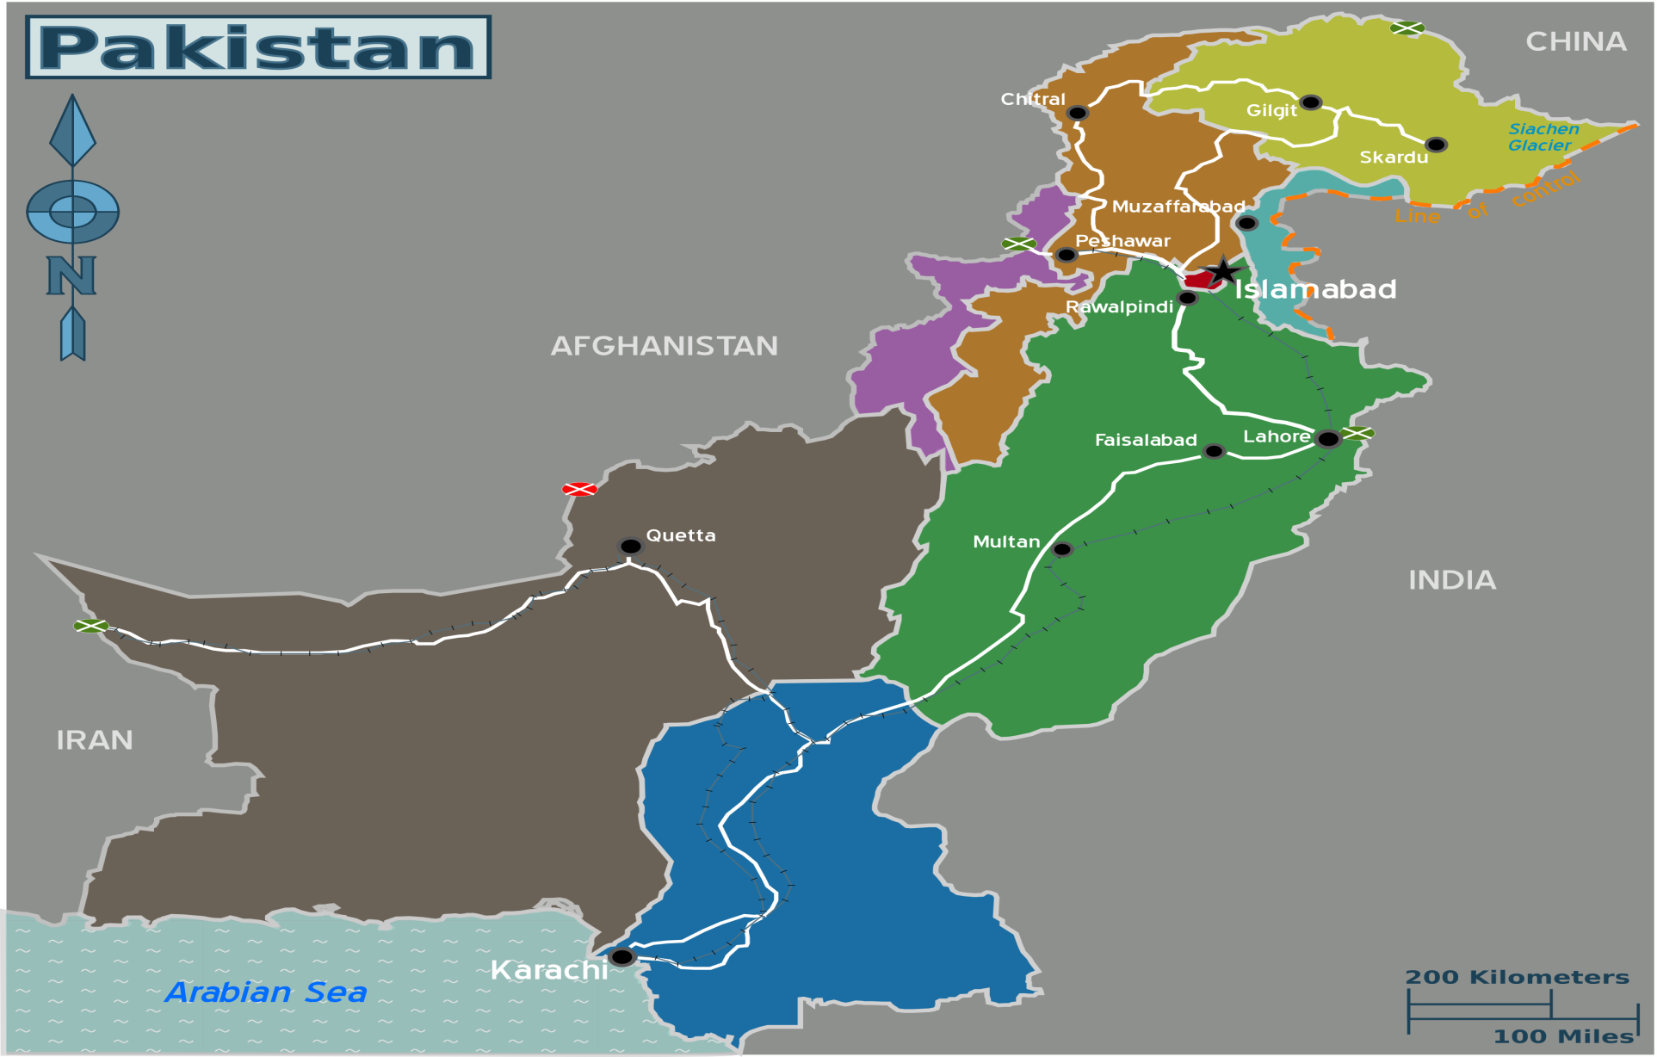
PAKISTAN

Slide 11
Indian Factor
India regarded as an existential threat to Pakistan
Hindu-Muslim antagonism
Kashmir dispute
Wars 1947-65-71-99
Cross border terrorism

Slide 12
Internal Factors
Demise of Jinnah
Assassination of Liaqat
With demise of Liaqat the parliamentary era came to an end
Bureaucratic interventions started
Governors rule imposed, chief ministers dismissed
Distance between 2 wings gave birth to number of administrative, political and constitutional problems

Slide 13
Internal threats
East Pakistan
Greater Pakhtunkhwa
FATA
Baluchistan
Karachi
Growing Extremism
Increased influence of VNSAs
Sectarian & ethnic divide
Internal security duties

Slide 14
Civil-military divide
Policies were primarily west –Pakistan centric
Increased frustration & deprivation in East-Pak
Delayed constitution making
Increased gulf between Punjabi elite & Bengali egalitarian leadership
East Pak demanded maximum provincial autonomy & West Pak desired strong center

Slide 15
East-West Pak –vested interests
Quantum of representation: East Pak had 54 pc population hence demanded universal adult franchise but leadership of west Pak was reluctant

Slide 16
Bad era for Parliamentary democracy
From 1951-58 , two Governor Generals , 1 Army chief and 7 Premiers were changed
Emergence of Ghulam Mohammad followed by Iskandar Mirza paved the path for military interventions
Stage was set for military who had been working in background
Initially Ayub Khan was reluctant to come into limelight

Slide 17
Political vacuum
In 1954 political forces wanted to reduce the powers of GG but GG dissolved the constituent assembly
PML lost its public standing – a political party vacuum
PML who provided a platform for the masses to attain a separate homeland failed to transform itself from a movement to a party

Slide 18
Role of Judiciary
1955 Maulvi Tamiz uddin case Justice Munir upheld the arbitrary decision of GG GM of the dissolution of first constituent assembly
It was carried out in the light of “Doctrine of necessity”
It opened doors for civil & military interventions
Role of judiciary from 1950’s to 2007 (ouster of Ch Iftikhar remained under critical review

Slide 19
Failure of politicians
PML failed to lead the nation for constitutionalism & economic development
PML lost its democratic ideals ,had annual conventions but after independence in 9 years no convention
Factional politics- inner infighting within PML
Widespread impression regarding corruption & inefficiency of politicians

Slide 20
Civil & military intervention
In the wake of weakening political culture country rapidly became dependent upon the civil & military bureaucratic support
Such need created space for civil & military interventions
Political parties failed to flourish as democratic entities
Successors of Jinnah failed to translate the ideals of Jinnah

Slide 21
Absence of autonomous election commission
11 years no elections
No independent election commission
One part of COD – had focus on electoral reforms
Ongoing strife between government & PTI primarily revolves around ‘reforms in ECP’

Slide 22
International factors
Cold war
Era of non aligned movement (NAM-1979)
Pakistan became member of military pacts
South East Asia Treaty Organization (SEATO)
CENTO (central treaty Organization) 1955-79
In post USSR invasion in Afghanistan ,Pak became strong US ally
In post 9/11 scenario Pakistan front line state in ongoing WOT
Notes:
120 members and 17 observer countries
founded in Belgrade in 1961, and was largely conceived by India's first prime minister, Jawaharlal Nehru; Indonesia's first president, Sukarno; Egypt's second president, Gamal Abdel Nasser; Ghana's first president Kwame Nkrumah; andYugoslavia's president, Josip Broz Tito.
17 summits ,last two in iran

Slide 23
Pro-US military establishment
Conspiracy theories

Slide 24
Military courts
Through a constitutional amendment military courts established
Challenged in Apex Court
11-6 ruling
Court validated military courts
Verdict will help counter –terror efforts

Slide 25
Sindh
Ongoing Rangers led operation in Karachi
Extension to Rangers in Sindh gave birth to new controversy between sindh & Center between civil & military relations
Are hopes after 18th amendment evaporating ?
Is Pakistan again heading towards another phase of hostilities between center-provinces

Slide 26
Poor capacity of civilian institutions
Army was employed for relief and recovery operation during 1948, 1950, 1955, 1956, 1973, 1975, 1976, 1978, 1998, 1992, 1995, 1998, 2001, 2003, 2010 and 2011 & 2014 floods
Anti-terrorism operations
Deployment during elections
Policing functions
Establishment of Special Security Division(10,000 persons)
Disaster management
Other areas

Slide 27
Chronology
Ayub Khan’s rule 1958-69
Yahiya's rule 1969-71
Zia’s rule 1977-88
Mushraf’s rule 1999-08
Wars
Ousted Junejo,ZAB,NS,BB
Political movements MRD,ARD
Devolution 2001-02
Akbar Bugti’s death
Lal Masjid Operation
17th amendment
Judicial activism

Slide 28
WAYFORWARD
National Security Council needs to be made operational & effective
More transparent constitutionally defined roles
Implementation of COD

